Slide 1

Active Reconnaissance (Con’t)
Spidering using OWASP ZAP (con’t)
1020-WAPT-Session 3.2

Slide 2
Contents Outline
Finding Directories and Files
dirb, dirbuster
Mapping the Web Application/Web Spidering
zap, burp
Finding Hidden Contents
robots.txt
Flow Charting
Contents Relationship Analysis
Summary
04/11/2020
11/4/2020
2
2

Slide 3
Finding Directories and Files
Web applications are stored in directories or folders that host them.
There are default starting folder in either Linux server or Windows server.
The applications will be stored under these start folders.
Pen-testers need to locate the directories and files related to the web application being pen-tested

Slide 4
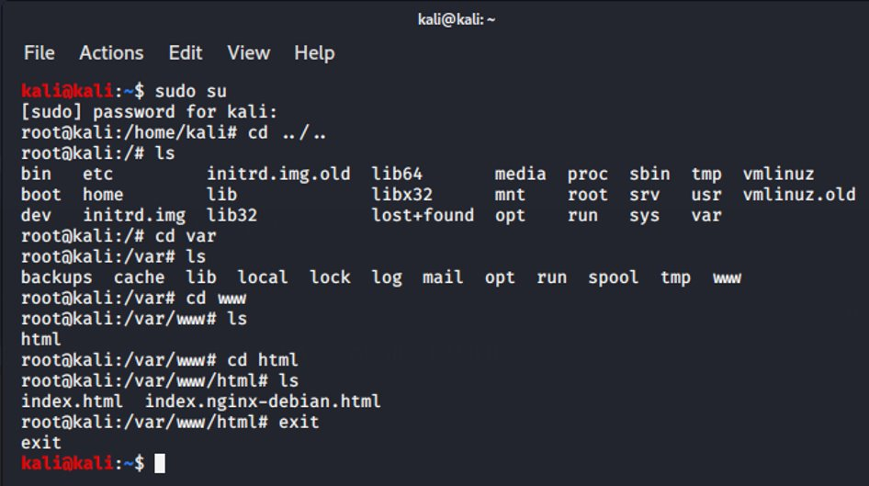
Default Start Folder for Linux Server

Slide 5
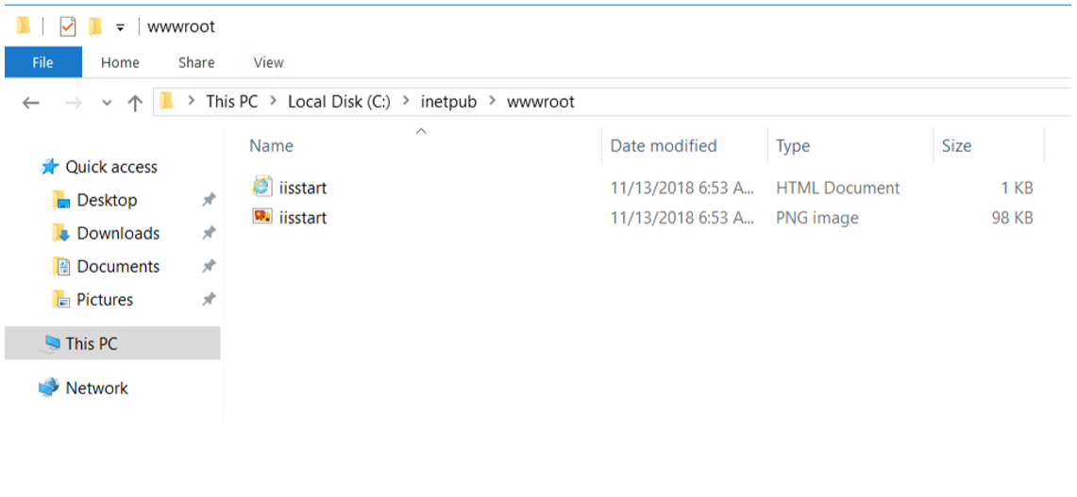
Default Start Folder for Windows Server

Slide 6
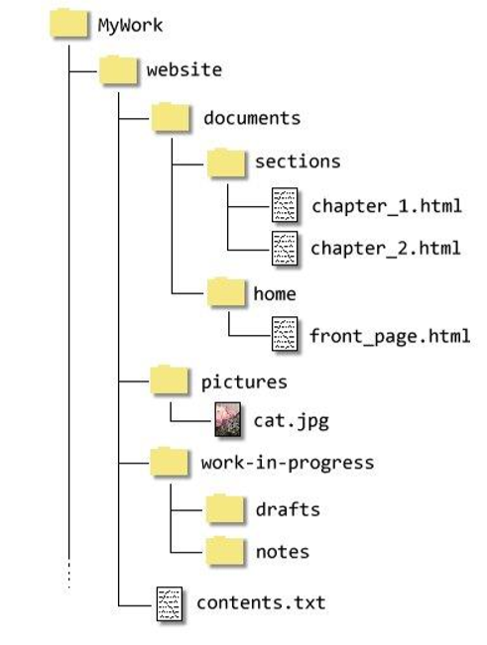
Typical Web Application Directory Structure

Slide 7
"dirb" - Directory brute forcing tool
Launch a dictionary-based attack against a web server and analyzing the response
Comes with a set of preconfigured attack wordlists for easy usage located at /usr/share/dirb/wordlists/
Can use custom wordlists

Slide 8
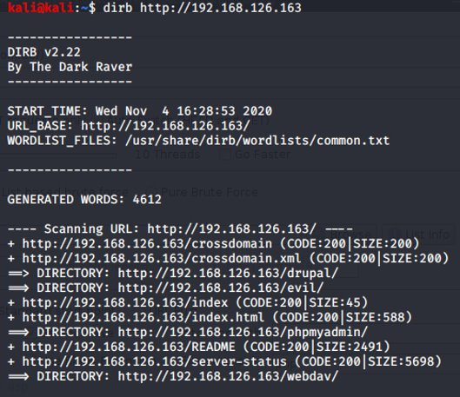
Directory brute forcing using "dirb“
dirb <bWAPP server IP address> <wordlist>
Bruit force w/o wordlist.

Slide 9
"dirbuster" - Directory brute forcing tool
Designed to brute force directories and files names on web/application servers.
Only good as the directory and file list they come with
Comes with a total of 9 different word lists
Generated from scratch, by crawling the Internet and collecting the directory and files that are actually used by developers

Slide 10
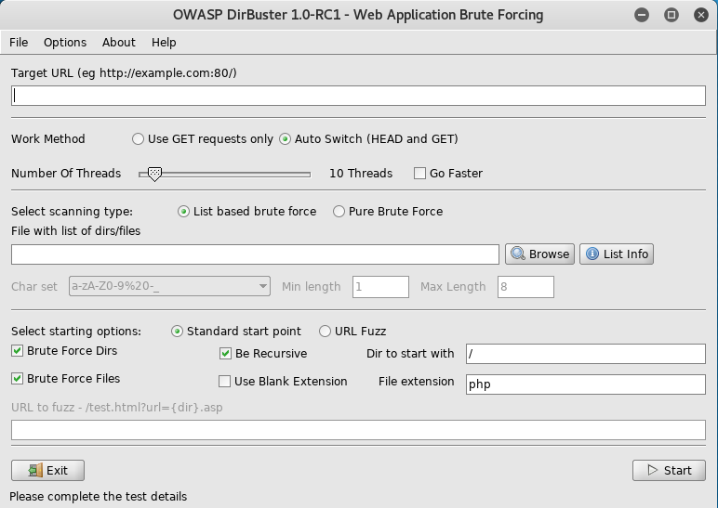
Directory brute forcing using “dirbuster”
#dirbuster

Slide 11
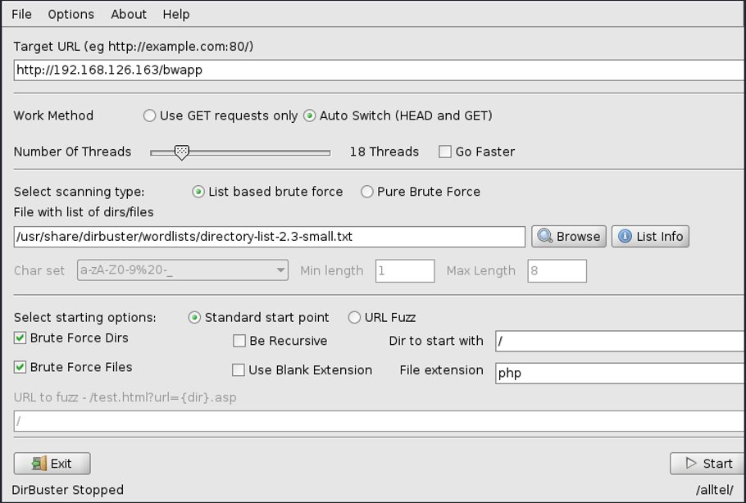

Slide 12
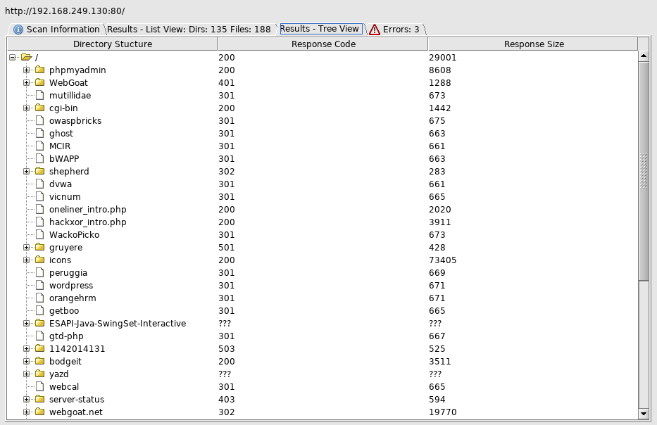

Slide 13
Activity 3.2.1 [Research] (Flipped Classroom)
Research on one of the following directory brute forcing tools or one that you found on the Internet:
Wfuzz
Gobuster
Work in team and document your answers in a PowerPoint file and submit to Week 3 Channel before start of 4.1 lesson in week 4.
Name your file as follows:
1020-A322-Members’ Name
.
11/4/2020
1020-WAPT-Session 2.1-Reconnaissance Basic
13

Slide 14
Concept of Spider/Crawler
In web application pen-testing, a crawler or spider is a tool that automatically goes through a website following all links in it and sometimes filling in and sending forms; this allows us to get a complete map of all of the referenced pages within the site and record the requests made to get them and their responses.

Slide 15
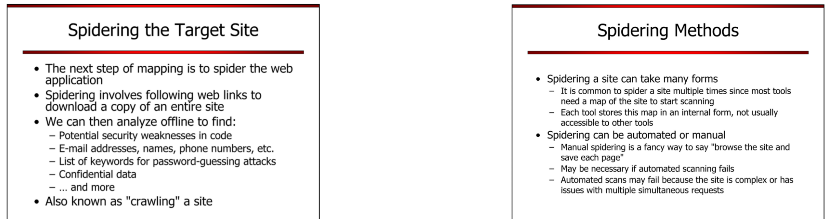
Spidering Target Site

Slide 16
Spidering Methods

Slide 17
OWASP ZAP
OWASP ZAP (short for Zed Attack Proxy) is an open-source web application security scanner. It is intended to be used by both those new to application security as well as professional penetration testers.
It is one of the most active Open Web Application Security Project (OWASP) projects and has been given Flagship status.
When used as a proxy server it allows the user to manipulate all of the traffic that passes through it, including traffic using https.

Slide 18
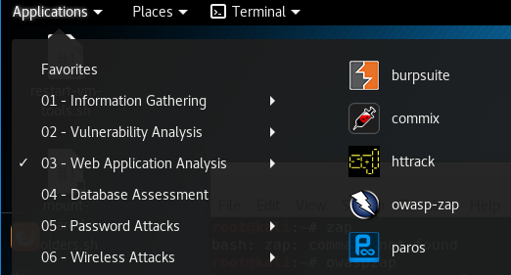
Spidering using OWASP ZAP
Start “owasp-zap”

Slide 19
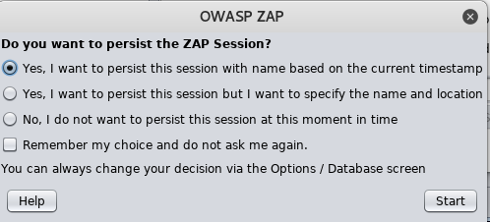
Spidering using OWASP ZAP (con’t)
Running for the first time, you may need to answer this question

Slide 20
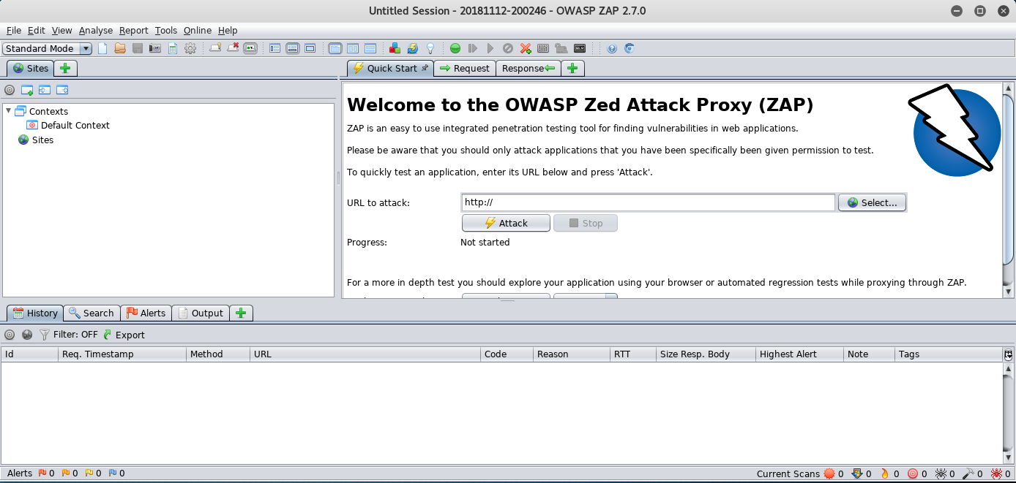
Spidering using OWASP ZAP (con’t)

Slide 21
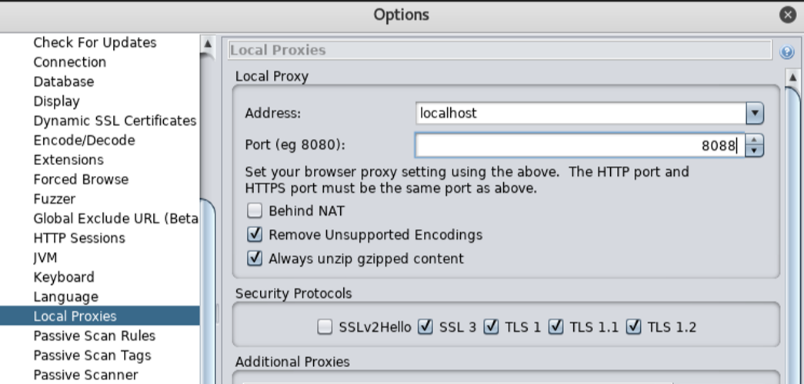
Spidering using OWASP ZAP (con’t)
By default, it uses port 8080, but that may interfere with other proxies like Burp Suite if we have them running at the same time. In ZAP, go to Tools | Options | Local Proxies and change the port to 8088:

Slide 22
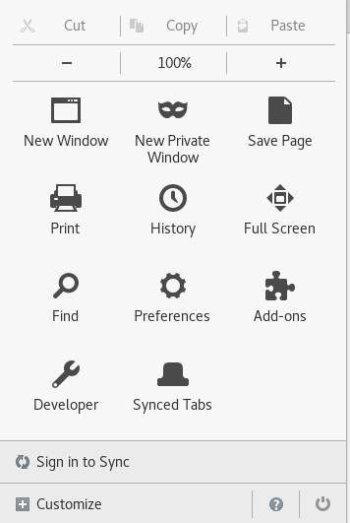
Spidering using OWASP ZAP (con’t)

Slide 23
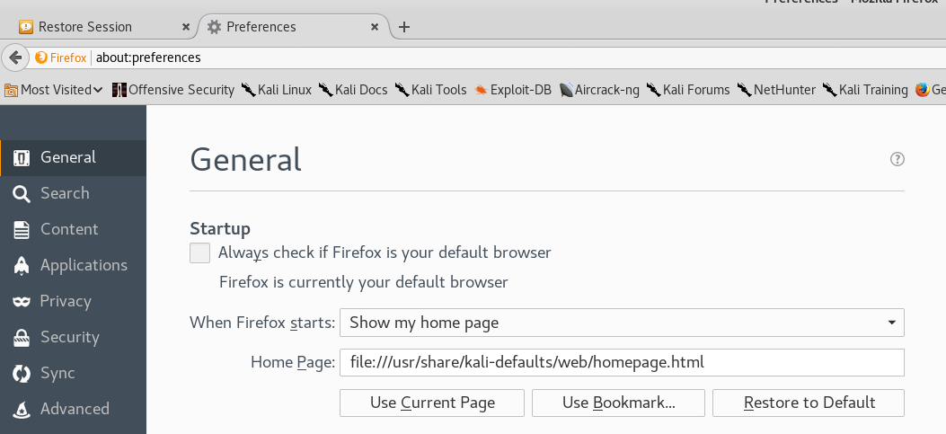
Spidering using OWASP ZAP (con’t)

Slide 24
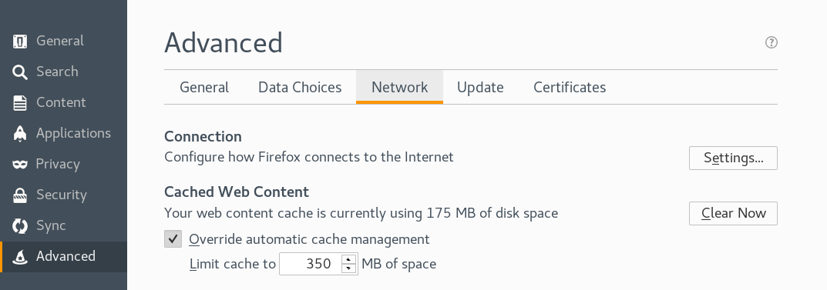
Spidering using OWASP ZAP (con’t)

Slide 25
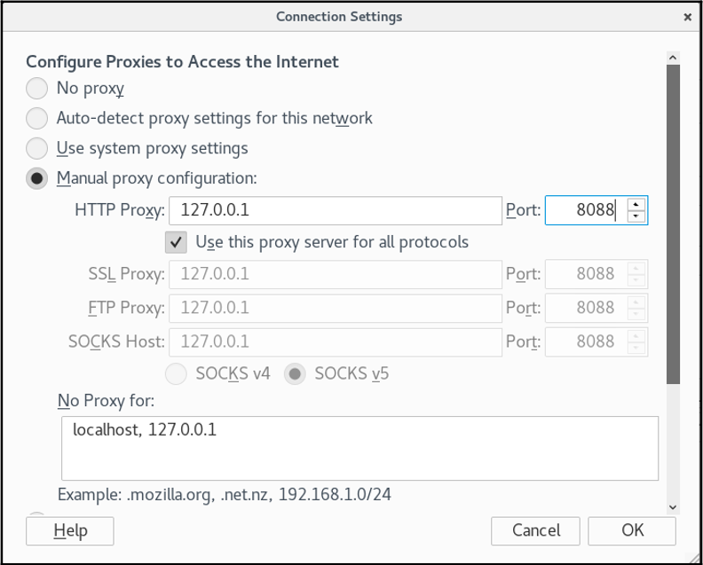
Spidering using OWASP ZAP (con’t)

Slide 26
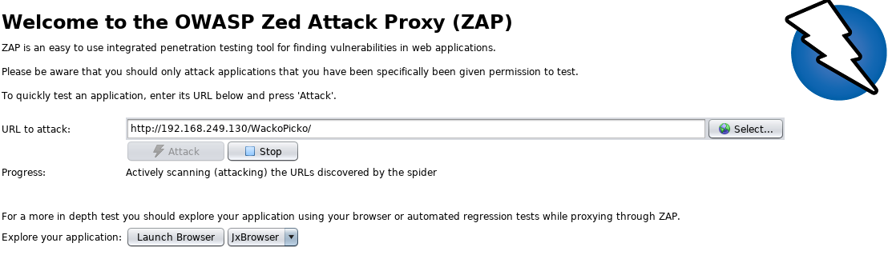
Spidering using OWASP ZAP (con’t)
Key in this URL 192.168.249.130/ WackoPicko into ZAP and start the attack.
Note IP address maybe different
WackoPicko Application in the OWASP Broken Web Application

Slide 27
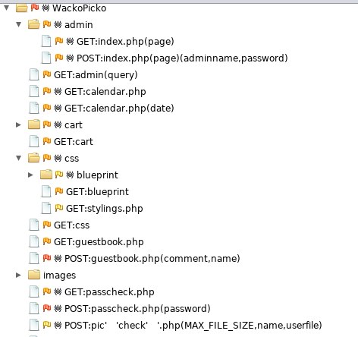
Spidering using OWASP ZAP (con’t)

Slide 28
Activity 3.2.2 [Skill Development] (Flipped Classroom)
Spider one of the following using “zap”
http://zero.webappsecurity.com
https://juice-shop.herokuapp.com
https://thisislegal.com/
Work in team and document your answers in a PowerPoint file and submit to Week 3 Channel before start of 4.1 lesson in week 4.
Name your file as follows:
1020-A323-Members’ Name
11/4/2020
1020-WAPT-Session 2.1-Reconnaissance Basic
28

Slide 29
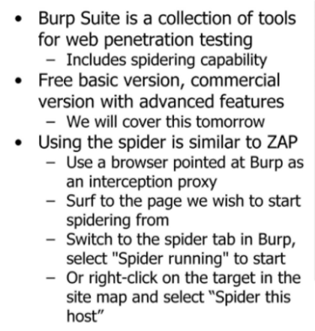
Spidering using Burp Suite

Slide 30
Spidering using Burp Suite (con't)
Start burpsuite

Slide 31
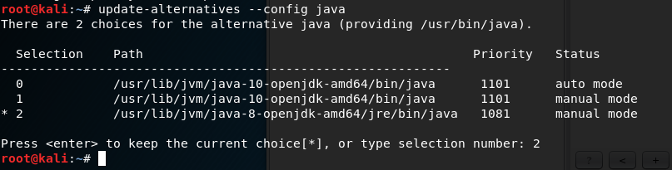
Spidering using OWASP ZAP (con’t)
If you hit into warning message on JRE 10 not tested with BurpSuite, do the following.

Slide 32
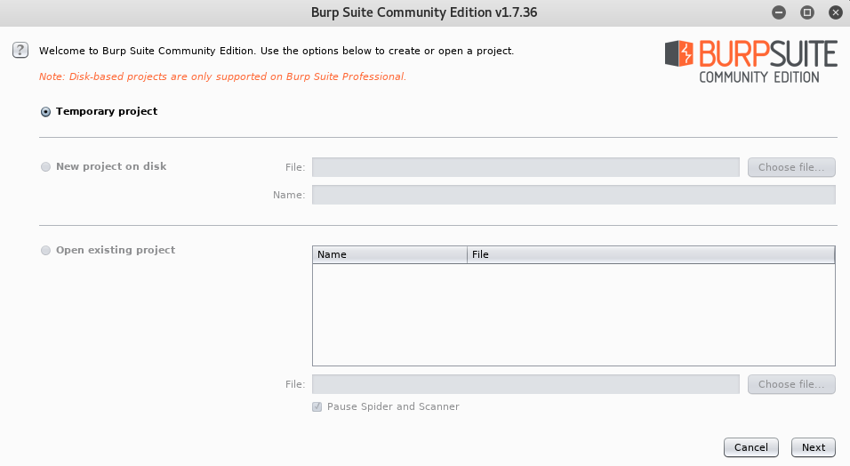
Spidering using OWASP ZAP (con’t)

Slide 33
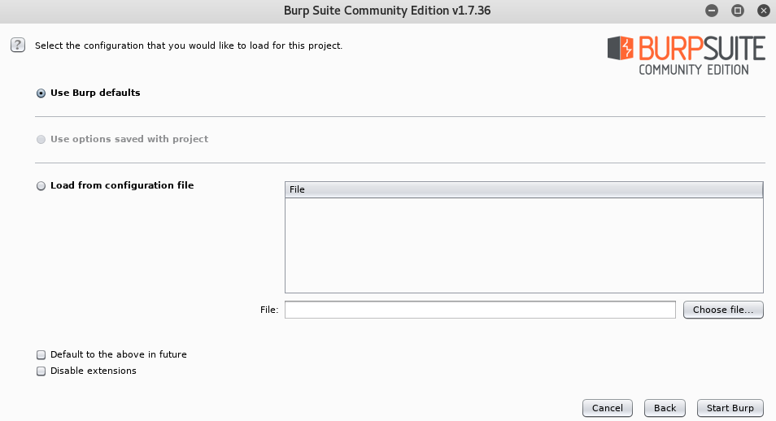
Spidering using OWASP ZAP (con’t)

Slide 34
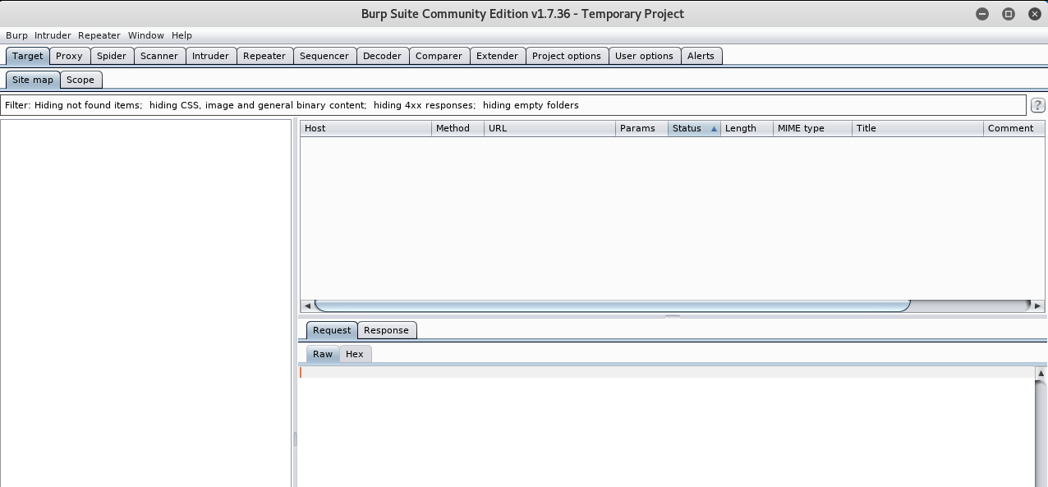
Spidering using OWASP ZAP (con’t)
34
If you hit into warning message on JRE 10 not tested with BurpSuite, do the following.

Slide 35
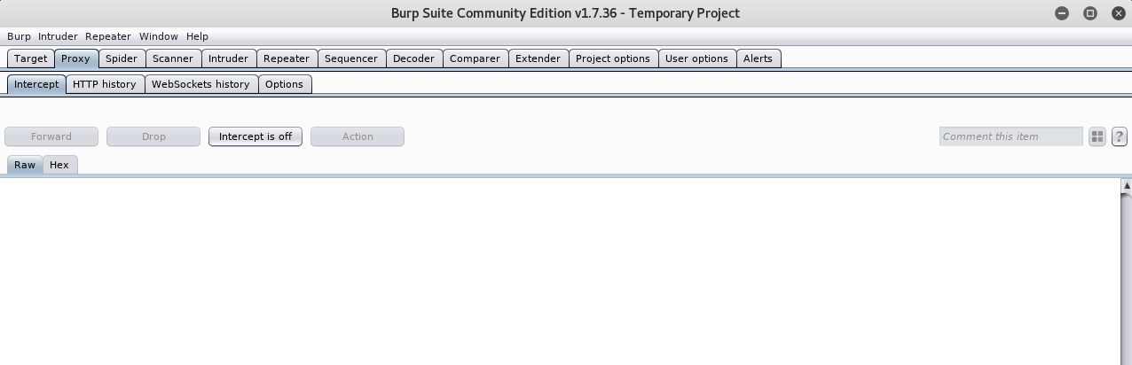
Spidering using Burp Suite

Slide 36
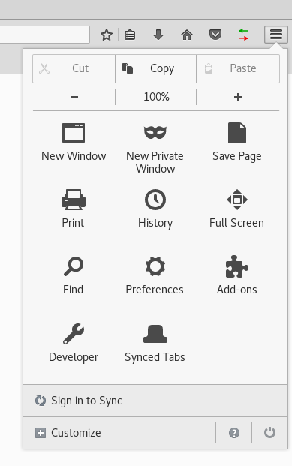
Spidering using OWASP ZAP (con’t)
Setup the browser in Kali Linux

Slide 37
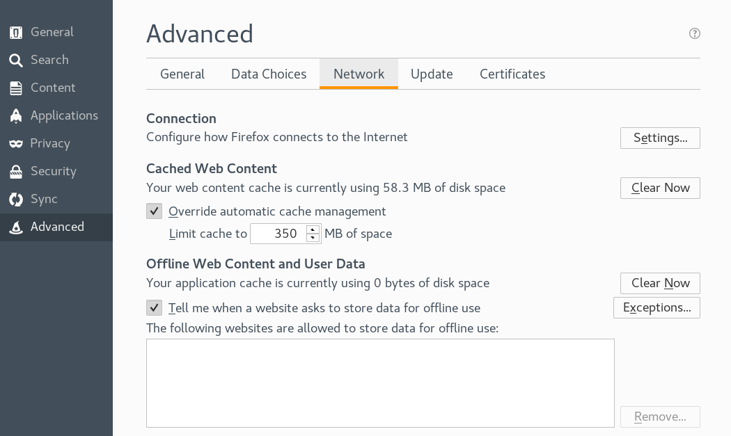

Slide 38
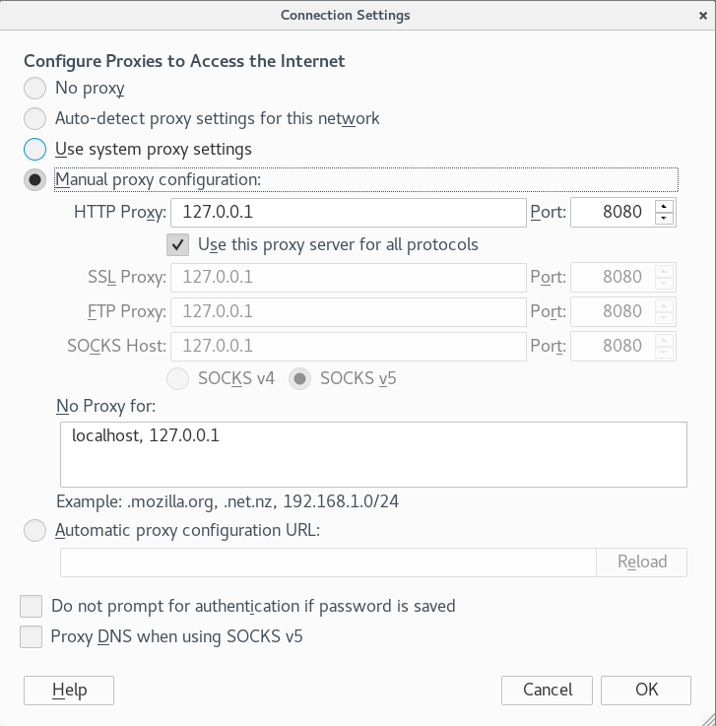

Slide 39
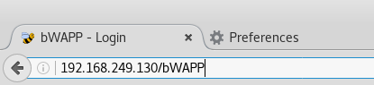
Spidering using OWASP ZAP (con’t)
Start browsing …using the browser in Kali Linux.
BWAPP Application in the OWASP Broken Web Application

Slide 40
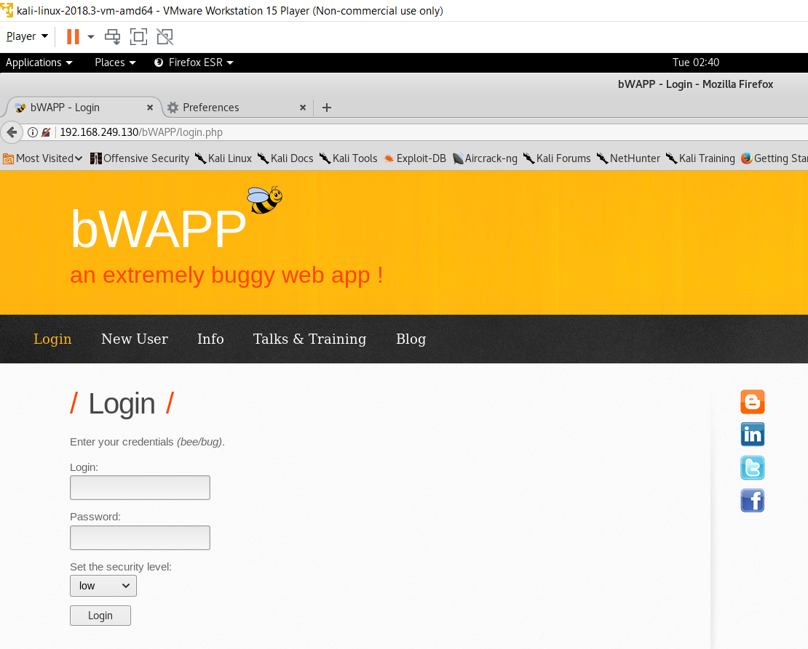
Spidering using OWASP ZAP (con’t)

Slide 41
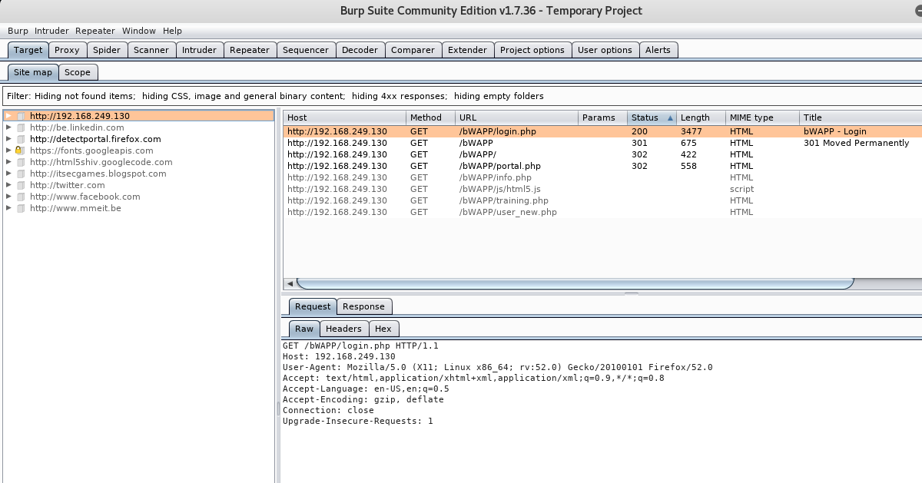
Spideringusing OWASP ZAP (con’t)
Examine the output from “burpsuite”

Slide 42
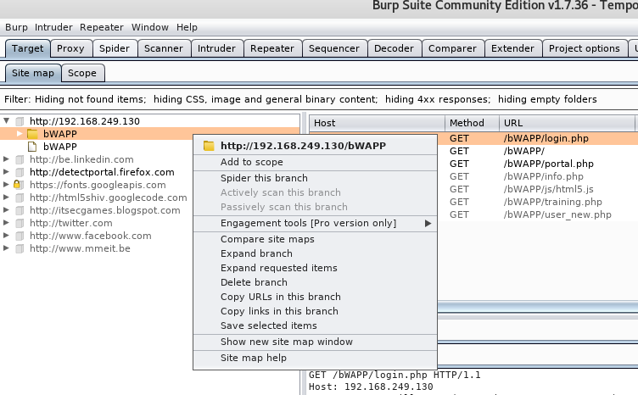
Spidering using OWASP ZAP (con’t)

Slide 43
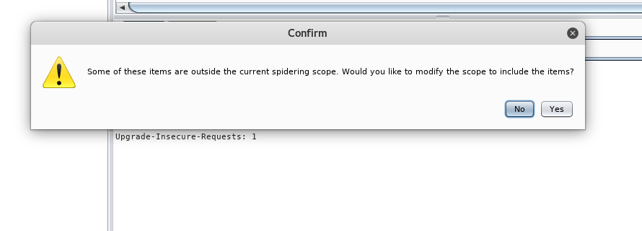
Spidering using OWASP ZAP (con’t)

Slide 44
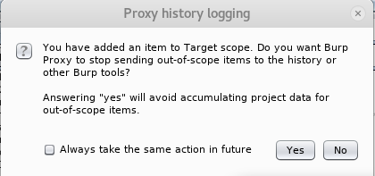
Spidering using OWASP ZAP (con’t)

Slide 45
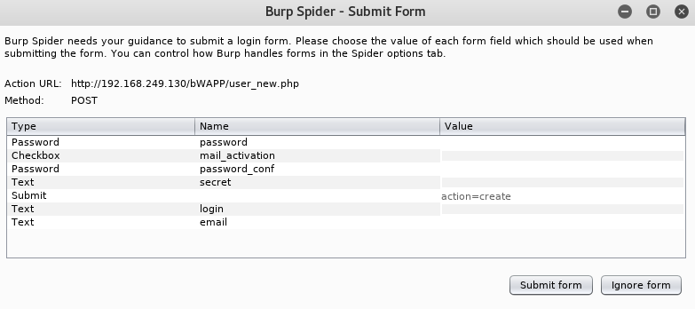
Spidering using OWASP ZAP (con’t)

Slide 46
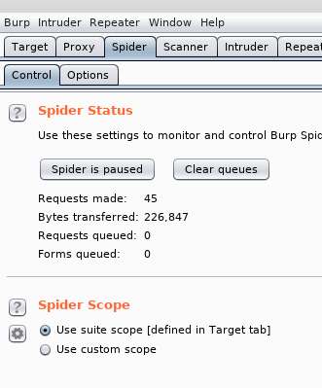
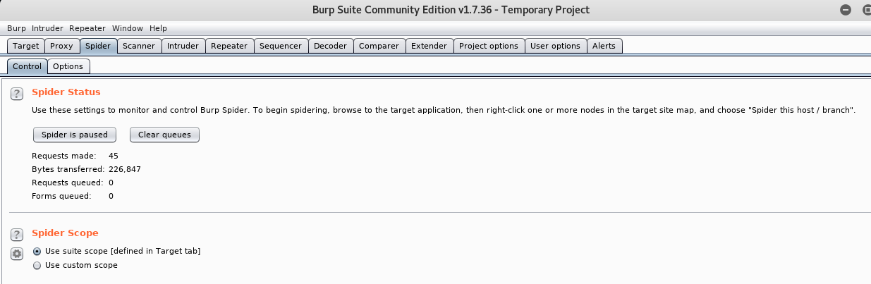
Spidering using OWASP ZAP (con’t)

Slide 47
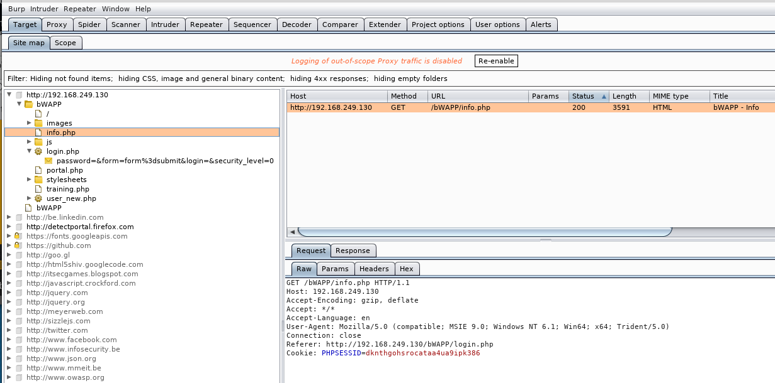
Spidering using OWASP ZAP (con’t)
47

Slide 48
Activity 3.2.3 [Skill Development] (Flipped Classroom)
Spider one of the following using “burp”
http://zero.webappsecurity.com
https://juice-shop.herokuapp.com
https://thisislegal.com/
Work in team and document your answers in a PowerPoint file and submit to Week 3 Channel before start of 4.1 lesson in week 4.
Name your file as follows:
1020-A324-Members’ Name
11/4/2020
1020-WAPT-Session 2.1-Reconnaissance Basic
48

Slide 49
Finding Hidden Contents with “robots.txt”
Web Robots (also known as Web Wanderers, Crawlers, or Spiders), are programs that traverse the Web automatically.
Search engines such as Google use them to index the web content
Web site owners use the /robots.txt file to give instructions about their site to web robots

Slide 50
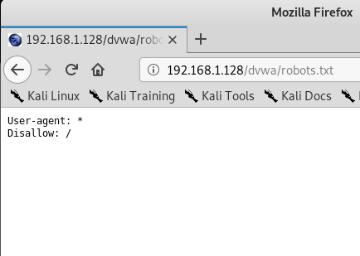
What is robots.txt?
The "User-agent: *" means this section applies to all robots.
The "Disallow: /" tells the robot that it should not visit any pages on the site
Robots can ignore your /robots.txt. Especially malware robots that scan the web for security vulnerabilities
robots.txt file is a publicly available file. Anyone can see what section of your server you don't want robots to use

Slide 51
Where is robots.txt?
Your site can have only one robots.txt file.
The robots.txt file must be located at the root of the website host to which it applies.
For instance, to control crawling on all URLs below http://www.example.com/ , the robots.txt file must be located at http://www.example.com/robots.txt .

Slide 52
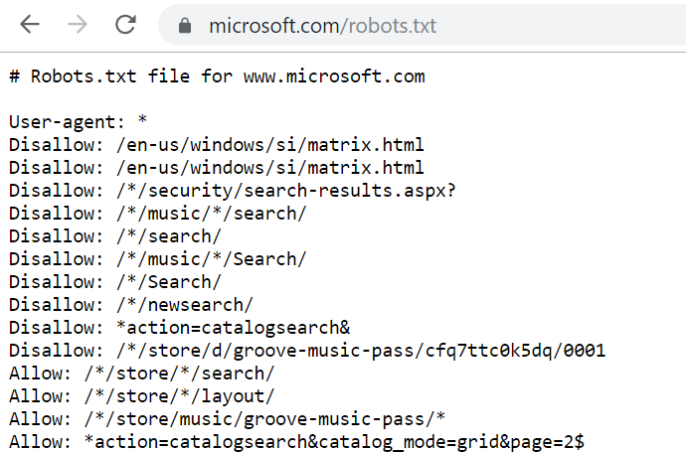

Slide 53
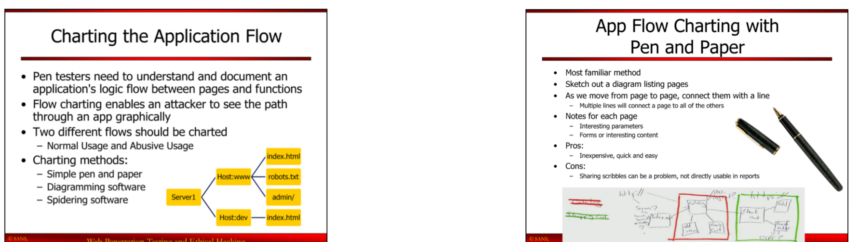
Flow Charting the Web Application

Slide 54
App Flow Charting with Pen and Paper

Slide 55
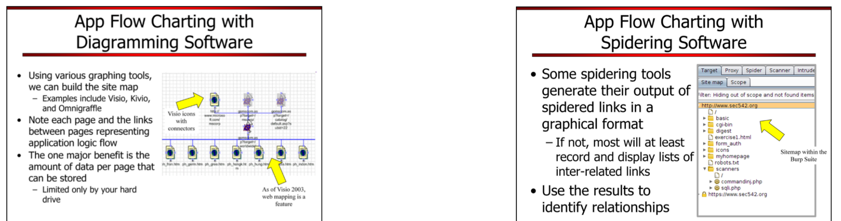
App Flow Charting with Diagramming Software

Slide 56
App Flow Charting with Spidering Software

Slide 57
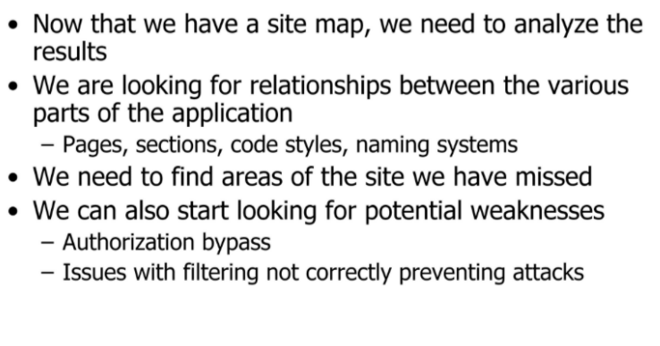
Contents Relationship Analysis

Slide 58
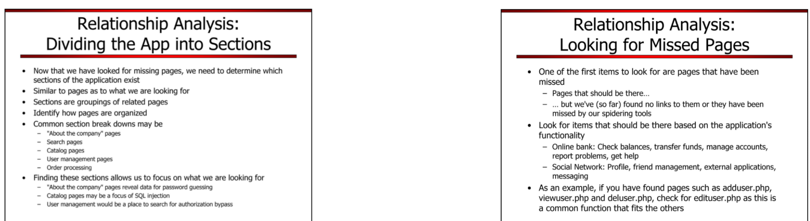
Dividing the App into Sections

Slide 59
Looking for Missed Pages

Slide 60
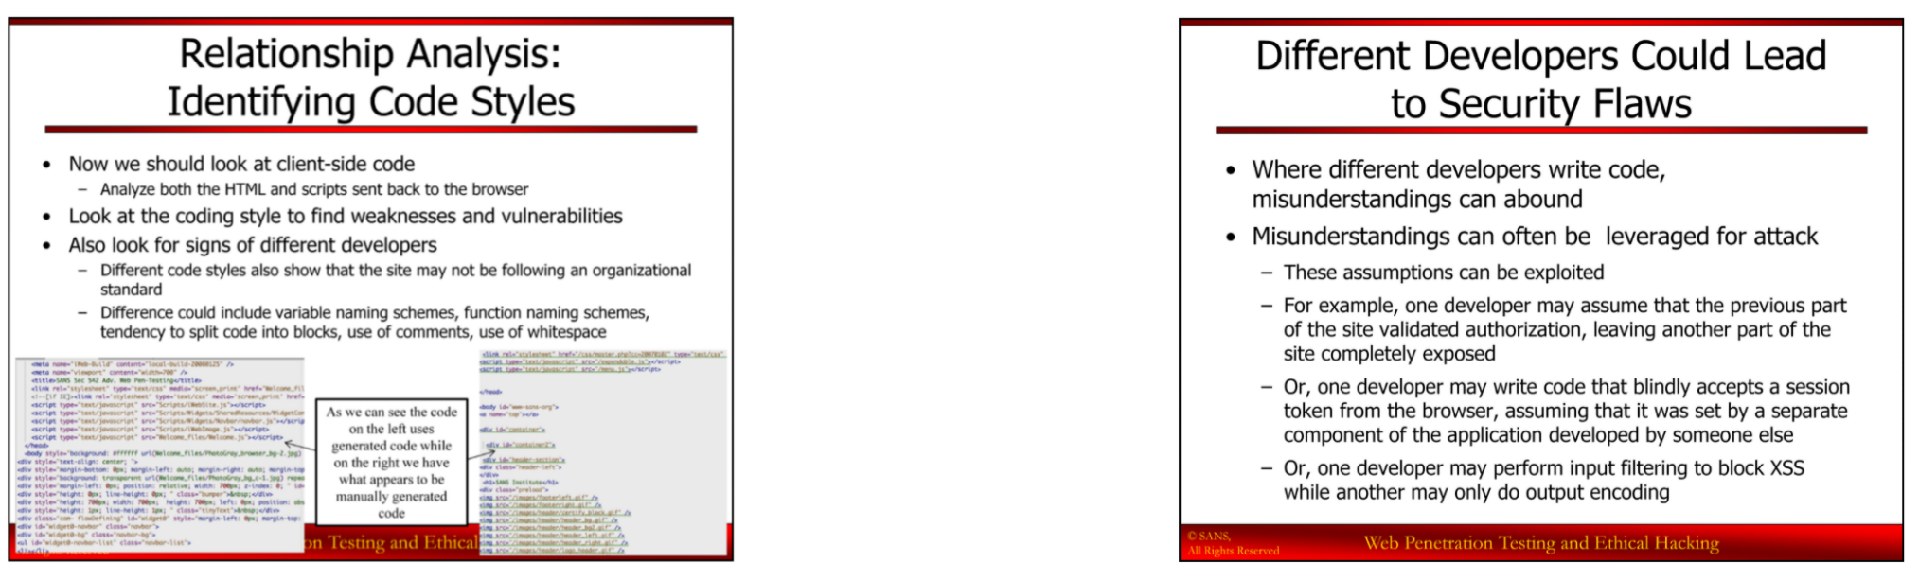
Identifying Code Styles

Slide 61
Different Developers Could Lead to Security Flaws

Slide 62
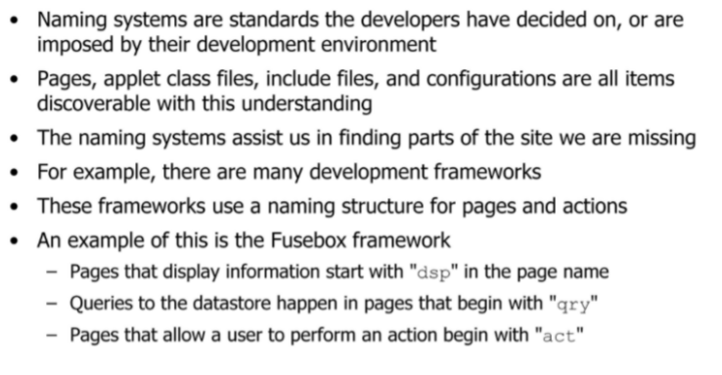
Identifying Naming Systems Used in a Web Application

Slide 63
Summary (What have we gone through under each of the following components?)
Component​ | Contents
Thinking​
Skill​s | dirb, dirbuster, zap, burp
Activity​ | Spidering using ZAP and Burp.
Knowledge​ | Finding Directories and Files, Mapping the Web Application/Web Spidering, Finding Hidden Contents, Flow Charting, Contents Relationship Analysis
11/4/2020
1020-WAPT-Session 2.1-Reconnaissance Basic
63

Slide 64
Feedback​
11/4/2020
1020-WAPT-Session 2.1-Reconnaissance Basic
64

Slide 65
Coming in 4.1
- OWASP No 1 – Injection Attack
11/4/2020
1020-WAPT-Session 2.1-Reconnaissance Basic
65

Slide 66
End

